Slide 1
William Stallings
Computer Organization and Architecture
7th Edition
Chapter 1
Introduction

Slide 2
Architecture & Organization 1
Architecture is those attributes visible to the programmer
  Instruction set, number of bits used for data representation, I/O mechanisms, addressing techniques.
  e.g. Is there a multiply instruction?
Organization is how features are implemented
  Control signals, interfaces, memory technology.
  e.g. Is there a hardware multiply unit or is it done by repeated addition?

Slide 3
Architecture & Organization 2
All Intel x86 family share the same basic architecture
The IBM System/370 family share the same basic architecture
This gives code compatibility
  At least backwards
Organization differs between different versions

Slide 4
Structure & Function
Structure is the way in which components relate to each other
Function is the operation of individual components as part of the structure

Slide 5
Function
All computer functions are:
  Data processing
  Data storage
  Data movement
  Control

Slide 6
Structure - Top Level
Computer
Peripherals
Central
Processing
Unit
Main
Memory
Computer
Systems
Interconnection
Input
Output
Communication
lines

Slide 7
Structure - The CPU
CPU
Computer
Arithmetic
and
Login Unit
I/O
Registers
System
Bus
CPU
Internal CPU
Interconnection
Memory
Control
Unit

Slide 8
Structure - The Control Unit
Control Unit
CPU
ALU
Sequencing
Login
Internal
Bus
Control
Unit
Control Unit
Registers and
Decoders
Registers
Control
Memory

Slide 9
Basic Computer Organization
Since the 1940's, computers have 3 classic components:
  Processor, called also the CPU (Central Processing Unit)
  Memory and Storage Devices
  I/O Devices
Interconnected with one or more buses
Bus consists of
  Data Bus
  Address Bus
  Control Bus
data bus
registers
Processor
(CPU)
Memory
I/O
I/O
Device
Device
#1
#2
ALU
CU
clock
control bus
address bus

Slide 10
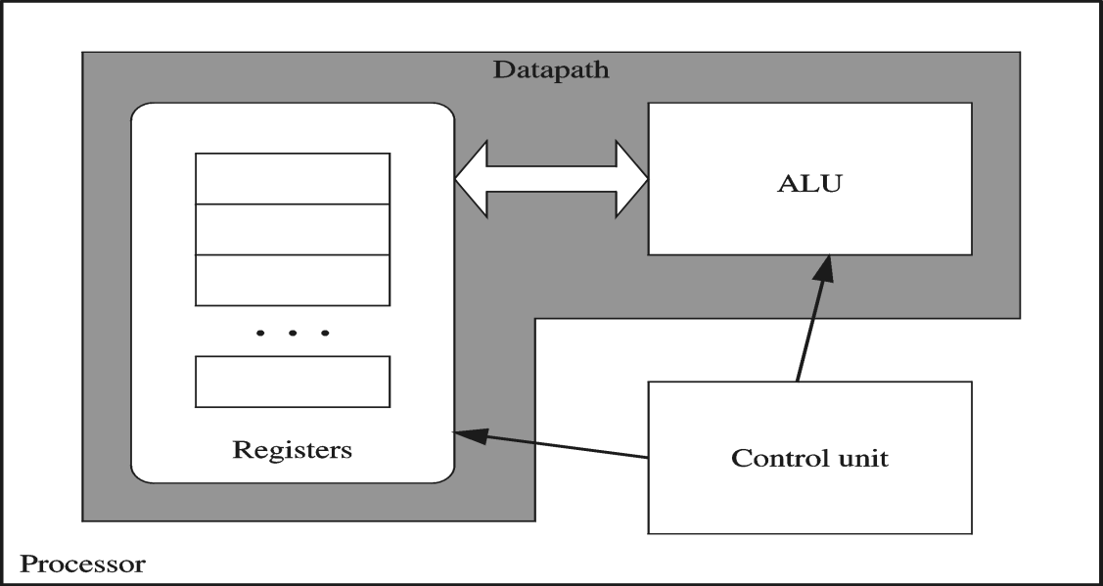
Processor
Processor consists of
  Datapath
    ALU
    Registers
  Control unit
ALU
  Performs arithmetic
  and logic instructions
Control unit (CU)
  Generates the control signals required to execute instructions
Implementation varies from one processor to another

Slide 11
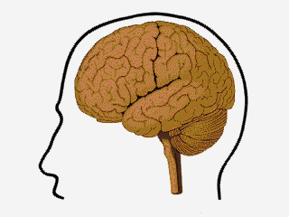
Movie clips of CPU

Slide 12
Clock
Synchronizes Processor and Bus operations
Clock cycle = Clock period = 1 / Clock rate
Clock rate = Clock frequency = Cycles per second
  1 Hz = 1 cycle/sec 1 KHz = 10³ cycles/sec
  1 MHz = 10⁶ cycles/sec 1 GHz = 10⁹ cycles/sec
  2 GHz clock has a cycle time = 1/(2×10⁹) = 0.5 nanosecond (ns)
Clock cycles measure the execution of instructions
Cycle 1
Cycle 2
Cycle 3

Slide 13
Memory
Ordered sequence of bytes
  The sequence number is called the memory address
Byte addressable memory
  Each byte has a unique address
  Supported by almost all processors
Physical address space
  Determined by the address bus width
  Pentium has a 32-bit address bus
    Physical address space = 4GB = 2³² bytes
  Itanium with a 64-bit address bus can support
    Up to 2⁶⁴ bytes of physical address space

Slide 14
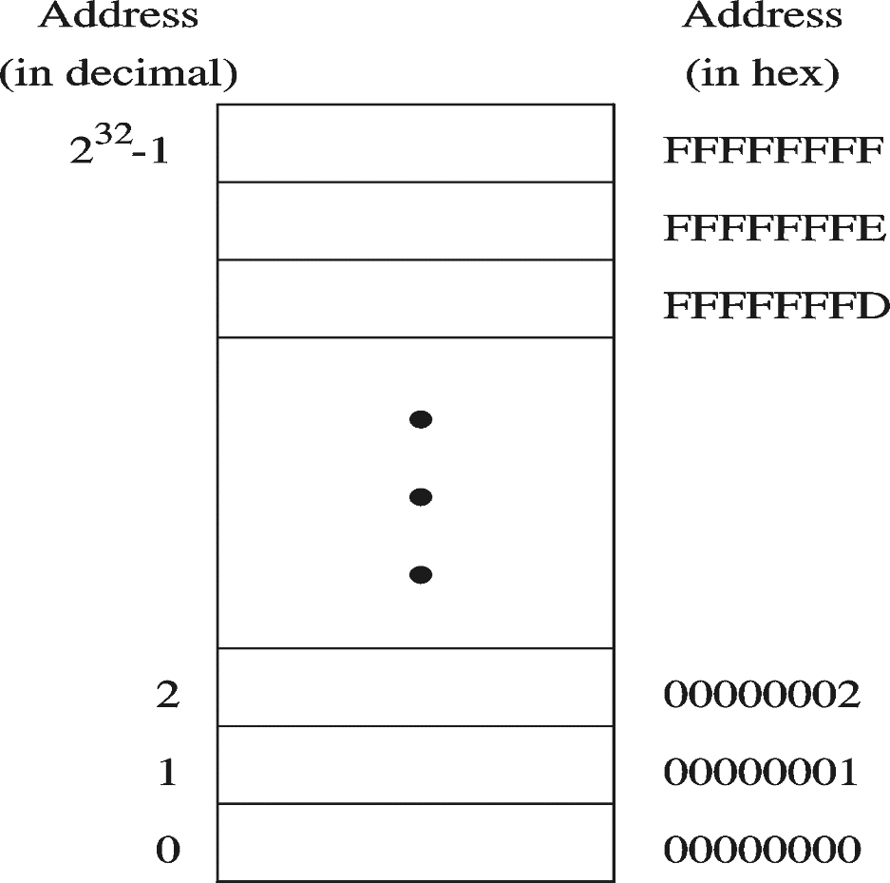
Address Space
Address Space is the set of memory locations (bytes) that can be addressed

Slide 15
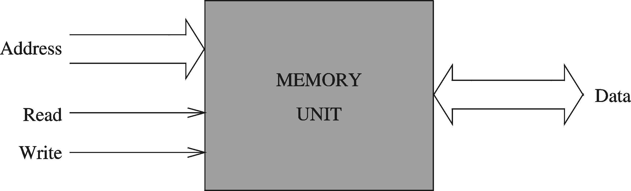
Memory Unit
Address Bus
  Address is placed on the address bus
  Address of location to be read/written
Data Bus
  Data is placed on the data bus
Two Control Signals
  Read
  Write
  Control whether memory should be read or written

Slide 16
Memory Read and Write Cycles
Read cycle
  1. Processor places address on the address bus
  2. Processor asserts the memory read control signal
  3. Processor waits for memory to place the data on the data bus
  4. Processor reads the data from the data bus
  Processor drops the memory read signal
Write cycle
  1. Processor places address on the address bus
  Processor asserts the memory write control signal
  Processor places the data on the data bus
  Wait for memory to store the data (wait states for slow memory)
  5. Processor drops the memory write signal

Slide 17
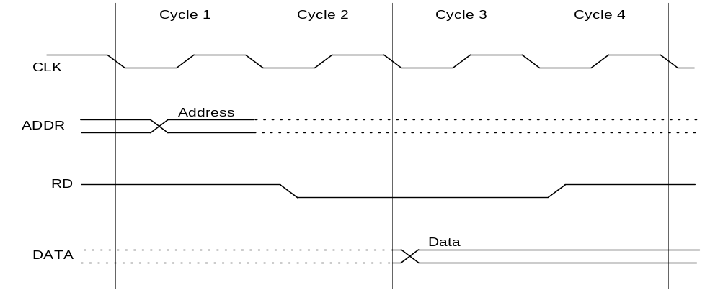
Reading from Memory
Multiple clock cycles are required
Memory responds much more slowly than the CPU
  Address is placed on address bus
  Read Line (RD) goes low, indicating that processor wants to read
  CPU waits (one or more cycles) for memory to respond
  Read Line (RD) goes high, indicating that data is on the data bus

Slide 18
Memory Devices
ROM = Read-Only Memory
  Stores information permanently (non-volatile)
  Used to store the information required to startup the computer
  Many types: ROM, EPROM, EEPROM, and FLASH
  FLASH memory can be erased electrically in blocks
RAM = Random Access Memory
  Volatile memory: data is lost when device is powered off
  Dynamic RAM (DRAM)
    Inexpensive, used for main memory, must be refreshed constantly
  Static RAM (SRAM)
    Expensive, used for cache memory, faster access, no refresh
  Video RAM (VRAM)
    Dual ported: read port to refresh the display, write port for updates

Slide 19
Memory Hierarchy
Registers
  Fastest storage elements, stores most frequently used data
  General-purpose registers: accessible to the programmer
  Special-purpose registers: used internally by the microprocessor
Cache Memory
  Fast SRAM that stores recently used instructions and data
  Recent processors have 2 levels
Main Memory (DRAM)
Disk Storage
  Permanent magnetic
  storage for files
registers
higher speed, smaller size
cache memory
lower cost per byte
main memory
disk storage

Slide 20
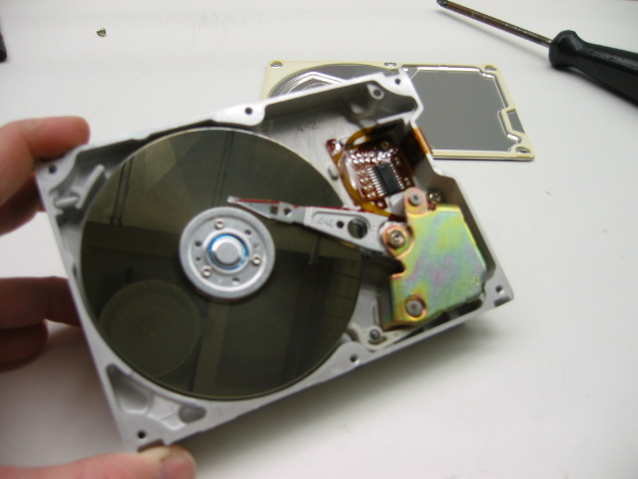
Magnetic Disk Storage
Disk Access Time =
Seek Time +
Rotation Latency +
Transfer Time
Sector
Read/write head
Actuator
Recording area
Seek Time: head movement to the desired track (milliseconds)
Rotation Latency: disk rotation until desired sector arrives under the head
Transfer Time: to transfer one sector
Track 2
Track 1
Track 0
Arm
Direction of rotation
Platter
Spindle

Slide 21
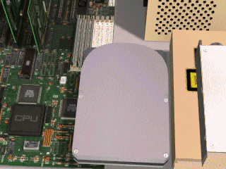
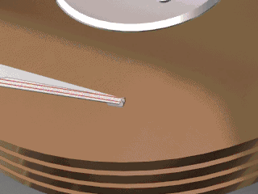
Some movie clips of Hard disks

Slide 22
Example on Disk Access Time
Given a magnetic disk with the following properties
  Rotation speed = 7200 RPM (rotations per minute)
  Average seek = 8 ms, Sector = 512 bytes, Track = 200 sectors
Calculate
  Time of one rotation (in milliseconds)
  Average time to access a block of 32 consecutive sectors
Answer
  Rotations per second
  Rotation time in milliseconds
  Average rotational latency
  Time to transfer 32 sectors
  Average access time
  = 7200/60 = 120 RPS
= 1000/120 = 8.33 ms
= time of half rotation = 4.17 ms
= (32/200) * 8.33 = 1.33 ms
= 8 + 4.17 + 1.33 = 13.5 ms

Slide 23
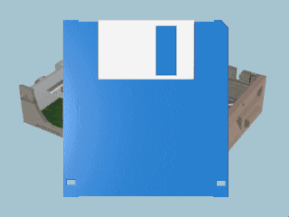
Movie of FAT

Slide 24
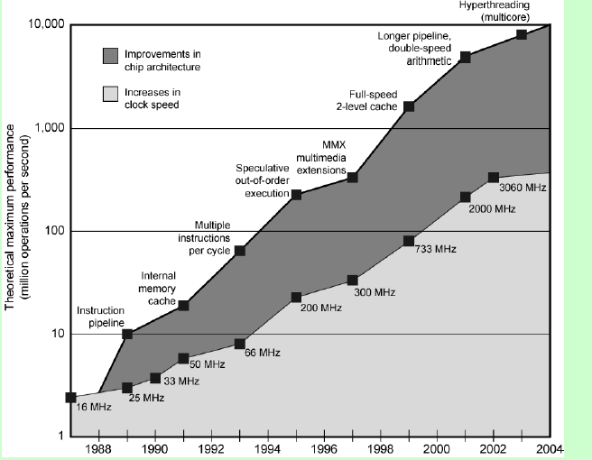
Intel Microprocessor Performance

Slide 25
Internet Resources
- Web site for book
http://WilliamStallings.com/COA/COA7e.html
  links to sites of interest
  links to sites for courses that use the book
  errata list for book
  information on other books by W. Stallings
http://WilliamStallings.com/StudentSupport.html
  Math
  How-to
  Research resources
  Misc

Slide 26
Internet Resources
- Web sites to look for
WWW Computer Architecture Home Page
CPU Info Center
Processor Emporium
ACM Special Interest Group on Computer Architecture
IEEE Technical Committee on Computer Architecture
Intel Technology Journal
Manufacturer’s sites
  Intel, IBM, etc.

